Slide 1
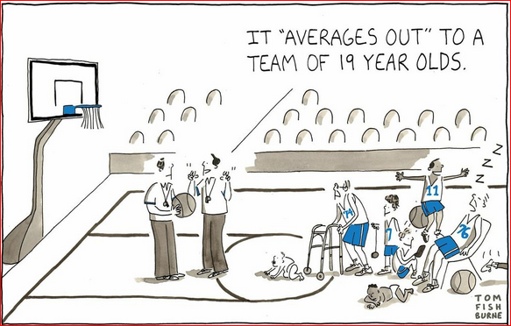
Averages

Slide 2
Types of Averages

Slide 4
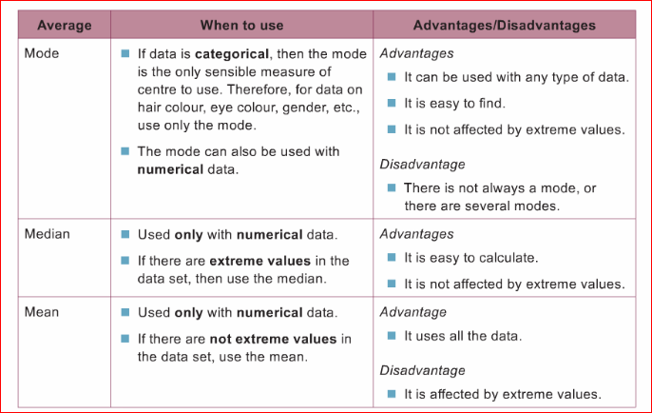

Slide 6
Mean, Mode, Median for discrete or continuous grouped frequency distributions
Grouped Frequency table
Frequency table
Mid-interval values

Slide 7
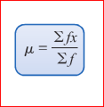
Mean of a frequency distribution table

Slide 8
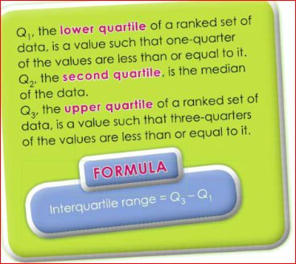
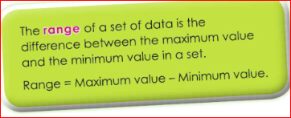
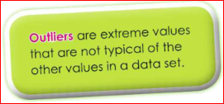
Measures of Variation (Variability of Data)

Slide 9
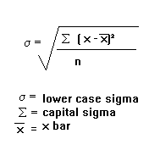
Standard Deviation (δ)

