Slide 1
Normal Distribution
IQ
Height
Blood pressure

Slide 2
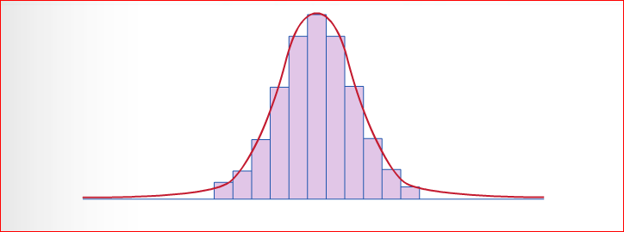
Normal Distribution Curve
Mean = mode = median
Symmetrical

Slide 3
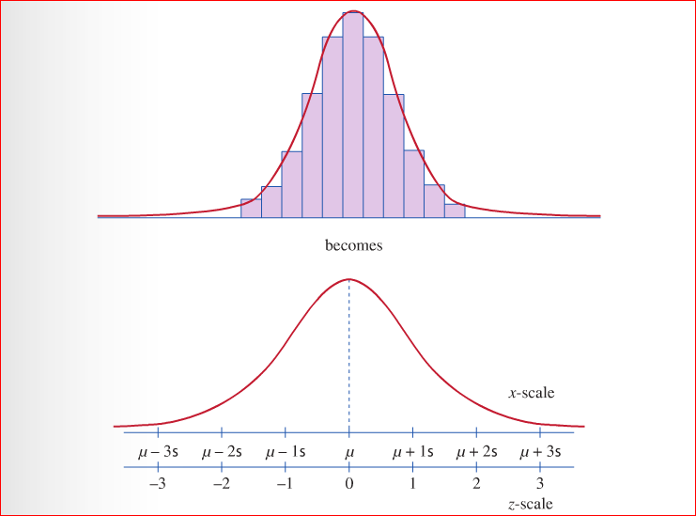

Slide 4
Z- tables and standardising scores
There are many different types of normal distribution, that is, there are many different examples (eg) height, IQ, mass, blood pressure etc that when the results are arranged in frequency, the same pattern shows up over and over again.
This same bell shape will have different means and standard deviations.
To avoid needing separate tables for each normal curve, we convert the units in the curve to standard units to get the standard normal distribution
These are called z-units

Slide 5

Formula for changing to z-units
$$z= \frac{x − μ}{σ}$$
$μ=the given mean$
$δ=the standard deviation$
$x=the given variable$

Slide 6
In any normal distribution:
68% of the distribution lies within 1 SD of the mean
$μ − σ and μ+ σ$
95% lies with in 2 SD of the mean
$μ −2σ and μ+2σ$
99.7% lies within 3 SD of the mean
$μ −3σ and μ+3σ$
A value of z tells us how many standard deviations the corresponding x-values lies above or below the mean

Slide 7
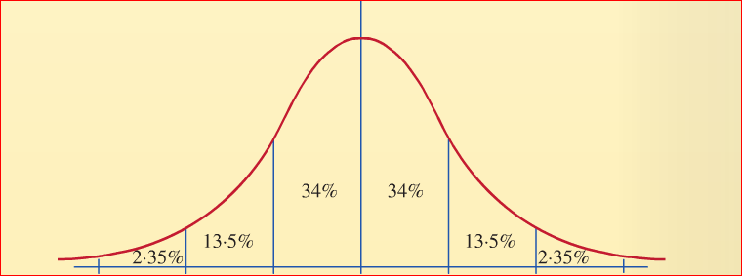

Slide 8
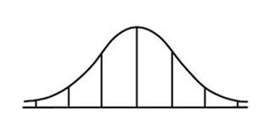

Slide 9
