Slide 1
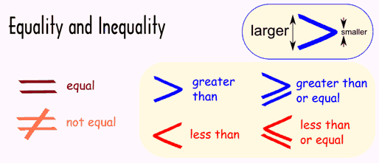
Equality & Inequality

Slide 2
Number Line

Slide 3
Number Systems
Natural Numbers
Integers
Real Numbers
Rational Numbers
Irrational Numbers

Slide 4
Natural Numbers
N
-all the positive whole numbers
No negatives
No decimals
No fractions
No surds
$\left(1,2,3,4,5,6,7,8,9,10,11…\right)$

Slide 5
Integers
Z
all the positive & negative whole numbers
No decimals
No fractions
No surds
$$\left(…−3,−2,−1,0,1,2,3…\right)$$

Slide 6
Real Numbers
R
The type of number we normally use, such as 1, 15.82, -0.1,$\frac{3}{4}$, etc. Positive or negative, large or small, whole numbers or decimal numbers are all Real Numbers.

