Slide 1
Polynomials
A polynomial f(x) has a factor (x-a) if and only if f(a) = 0
$$f\left(x\right)=a_{n}x^{n}+a_{n−1}x^{n−1}+…+a_{1}x+a_{0}$$
Where all the powers are non-negative whole numbers and all the a’s are constants

Slide 2
What are we looking to do with Polynomials?
Solve them.
This means we are looking to find out where they cross the x-axis using algebra (factor theorem)
These are called roots or zeros
This then helps to draw the graph
Where it crosses the x-axis(roots)
Maximum and minimum turning points
Which way the arms of the graph are pointing

Slide 3
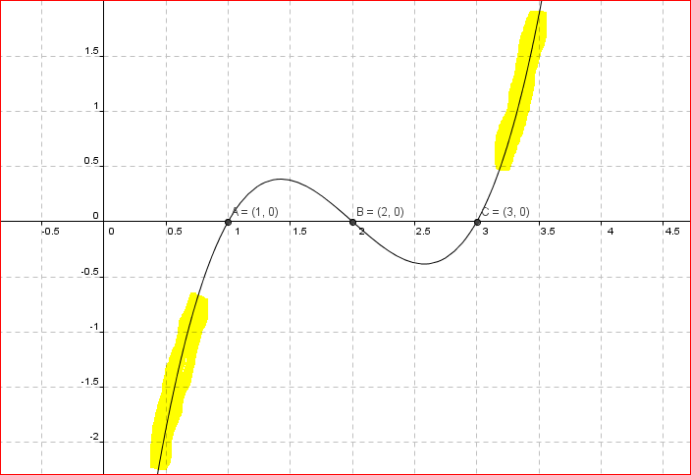
Cubic Curve

Slide 4
Using Graphs to Estimate a Polynomial
Keys points:
Values of x for which f(x) = 0 are called the ROOTS or ZEROS of the function
DEGREE of the polynomial is the highest power within the polynomial
Maximum number of distinct roots is the same as degree
Leading coefficient of polynomial is the coefficient of the term with the highest power

Slide 5
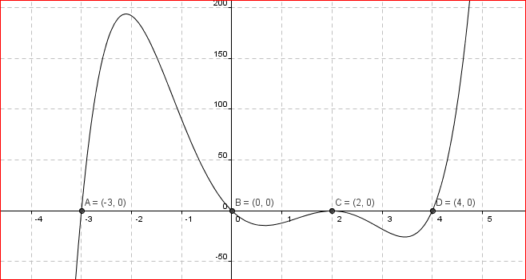
Multiplicity
Some polynomials might have a factor or root occur more than once
${(x−a)}^{n} , \left(a ∈R, n ∈N\right)$
Root repeated - multiplicity

Slide 6
Important Points
Multiplicity
$${(x −a)}^{n} , a∈R, n∈N$$
If n is even $=>$graph touches the x-axis here but does not cross
If n is odd $=>$ graph crosses the x-axis at x=a
If the polynomial has a factor with an odd multiplicity greater than 1 it appears to flatten before and after it crosses the axis

Slide 7
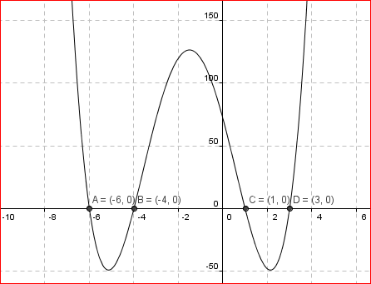
Polynomial End Behaviour – (LHS & RHS)
Even degree – arms both up or both down
$$f\left(x\right)=x^{4}+6x^{3} −13x^{2} −66x+ 72$$

Slide 8
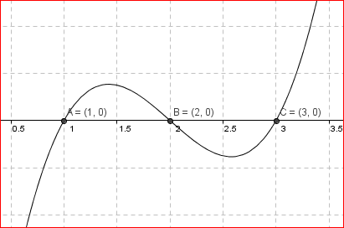

2. Odd degree – one arm up and one arm down
$$f\left(x\right)= x^{3} −6x^{2}+11x −6$$
UP
DOWN

Slide 9
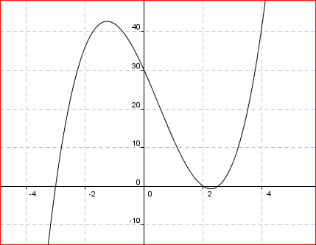
3. Leading coefficient is positive – right arm up
$$f\left(x\right)=2x^{3}−3x^{2}−17x+30$$
Right Arm

Slide 10
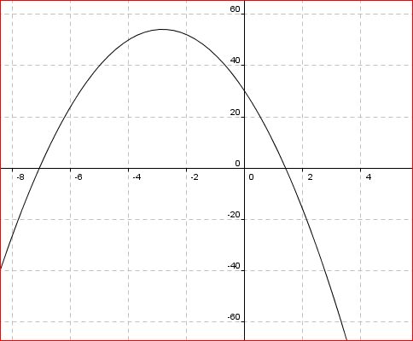
4. If the leading coefficient is negative – right arm down
$$f\left(x\right)=−3x^{2}−17x+30$$
Right Arm Down

