Slide 1
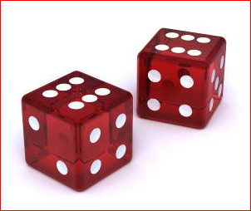
Probability
What chance have we of getting no homework from Mr. Barry tonight???

Slide 2
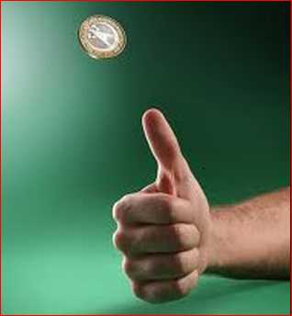
Chance and Probability
When we flip a coin and if we pick Heads, what chance have we of being right?
Well, there are 2 sides to a coin and only one of the sides is a Head.
Does this mean that we have 1 chance in 2?
Is there any other way of describing this?

Slide 3
1 Chance in 2
_____
_____
_____
_____
_____

Slide 4
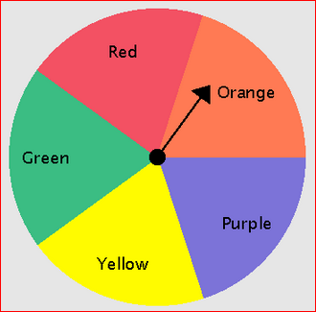
Impossible
What chance have we of getting Blue on the spinner?
_____
_____
_____
_____
_____

Slide 5
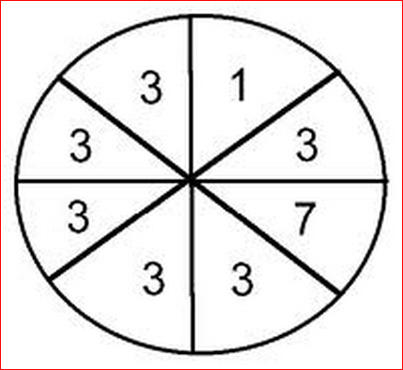
Certain
What chance have we of picking an ODD number on the spinner?
_____
_____
_____
_____
_____
Are there any examples of things that are certain?

Slide 6
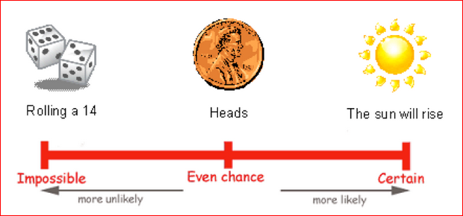
Probability Scale

Slide 7
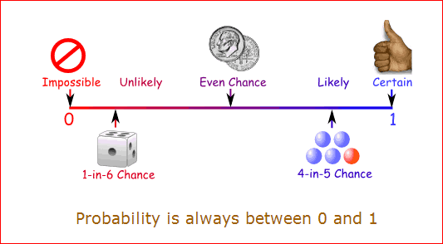
Probability Scale

